Slide 1
eMasters – Communication Systems E901-Probability and Random Processes
Notes, References, Questions, Problems, and Solutions
Venkateswar Reddy Melachervu
Jan 2023

Slide 2
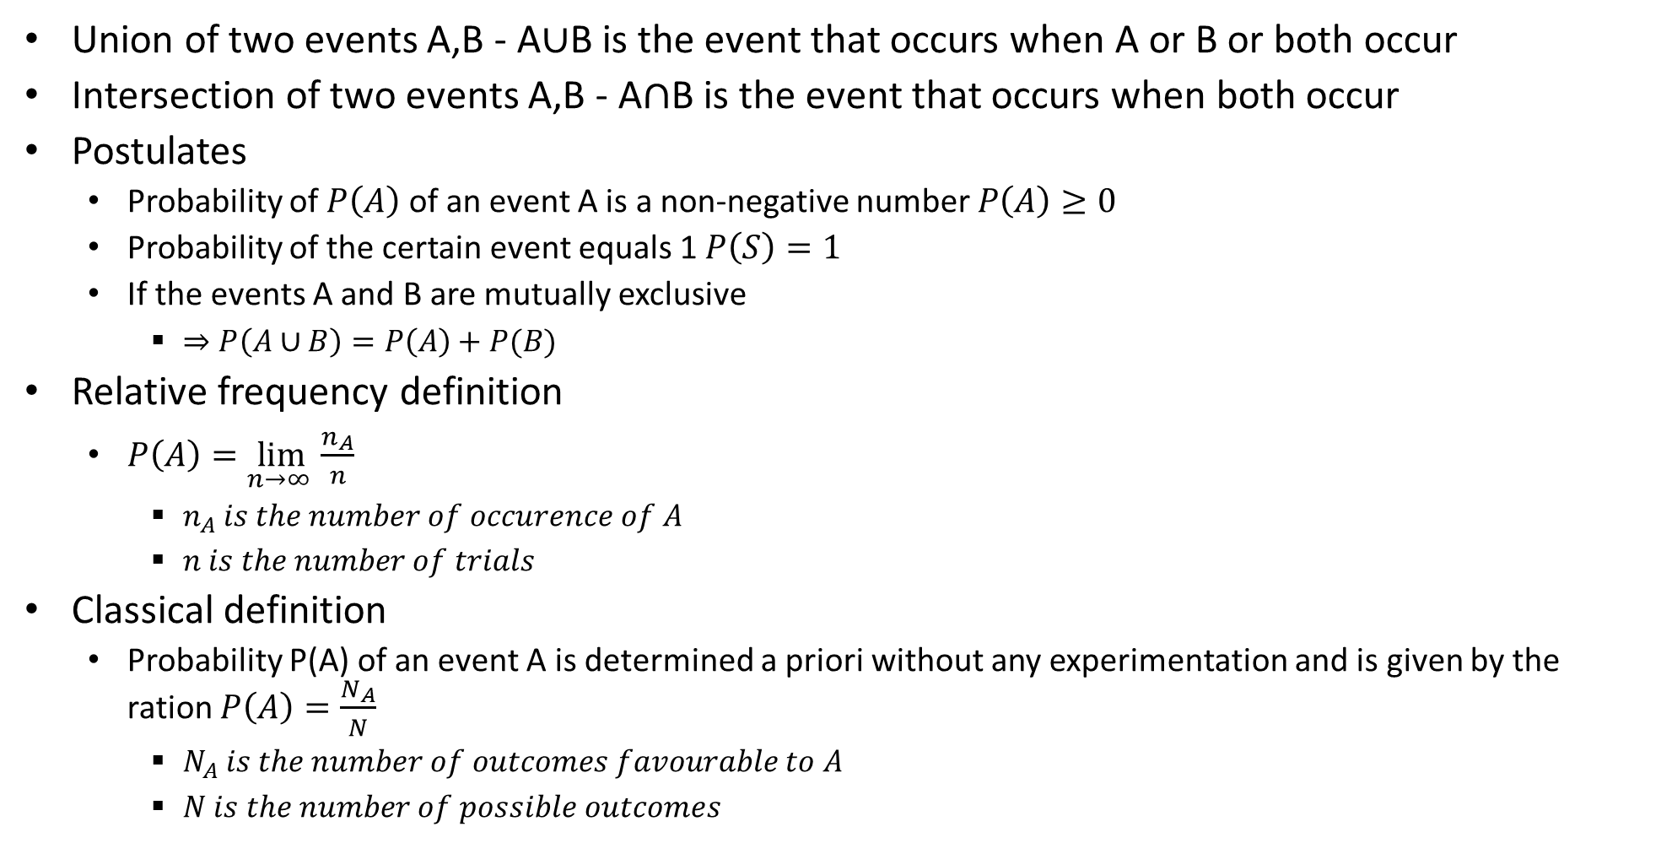
Probability – Theory
Union of two events A,B - A$∪$B is the event that occurs when A or B or both occur
Intersection of two events A,B - A$∩$B is the event that occurs when both occur
Postulates
Probability of $P\left(A\right)$ of an event A is a non-negative number $P\left(A\right)≥0$
Probability of the certain event equals 1 $P\left(S\right)=1$
If the events A and B are mutually exclusive
$⇒P\left(A∪B\right)=P\left(A\right)+P(B)$
Relative frequency definition
$P\left(A\right)=\lim_{n→∞ }{\frac{n_{A}}{n}}$
$n_{A} is the number of occurence of A$
$n is the number of trials$
Classical definition
Probability P(A) of an event A is determined a priori without any experimentation and is given by the ration $P\left(A\right)=\frac{N_{A}}{N}$
$N_{A} is the number of outcomes favourable to A$
$N is the number of possible outcomes$

Slide 3
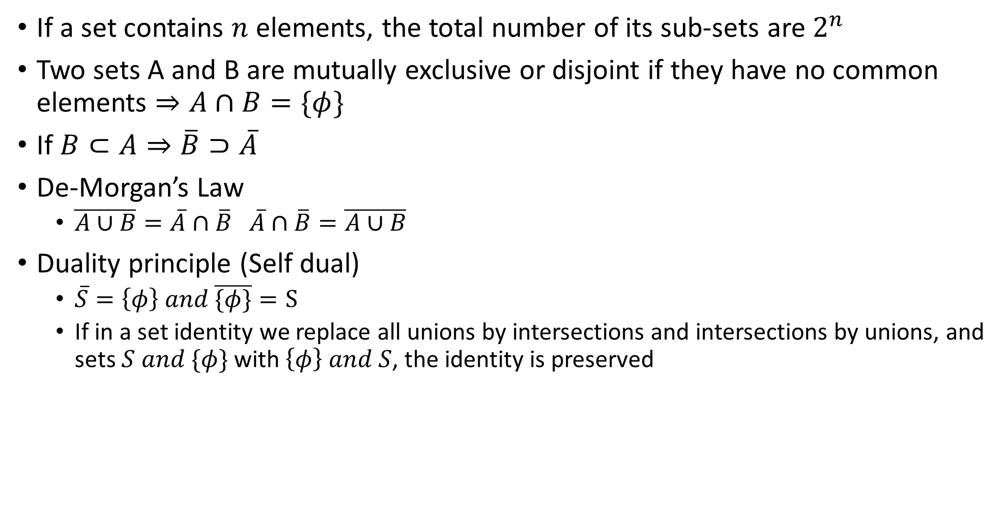
Set Theory
If a set contains $n$ elements, the total number of its sub-sets are $2^{n}$
Two sets A and B are mutually exclusive or disjoint if they have no common elements $⇒A∩B=\{φ\}$
If $B⊂A⇒\overline{B}⊃\overline{A}$
De-Morgan’s Law
$\overline{A∪B}=\overline{A}∩\overline{B} \overline{A}∩\overline{B}=\overline{A∪B}$
Duality principle (Self dual)
$\overline{S}=\left\{φ\right\} and \overline{\{φ\}}=S$
If in a set identity we replace all unions by intersections and intersections by unions, and sets $S and \{φ\}$ with $\left\{φ\right\} and S$, the identity is preserved

Slide 4

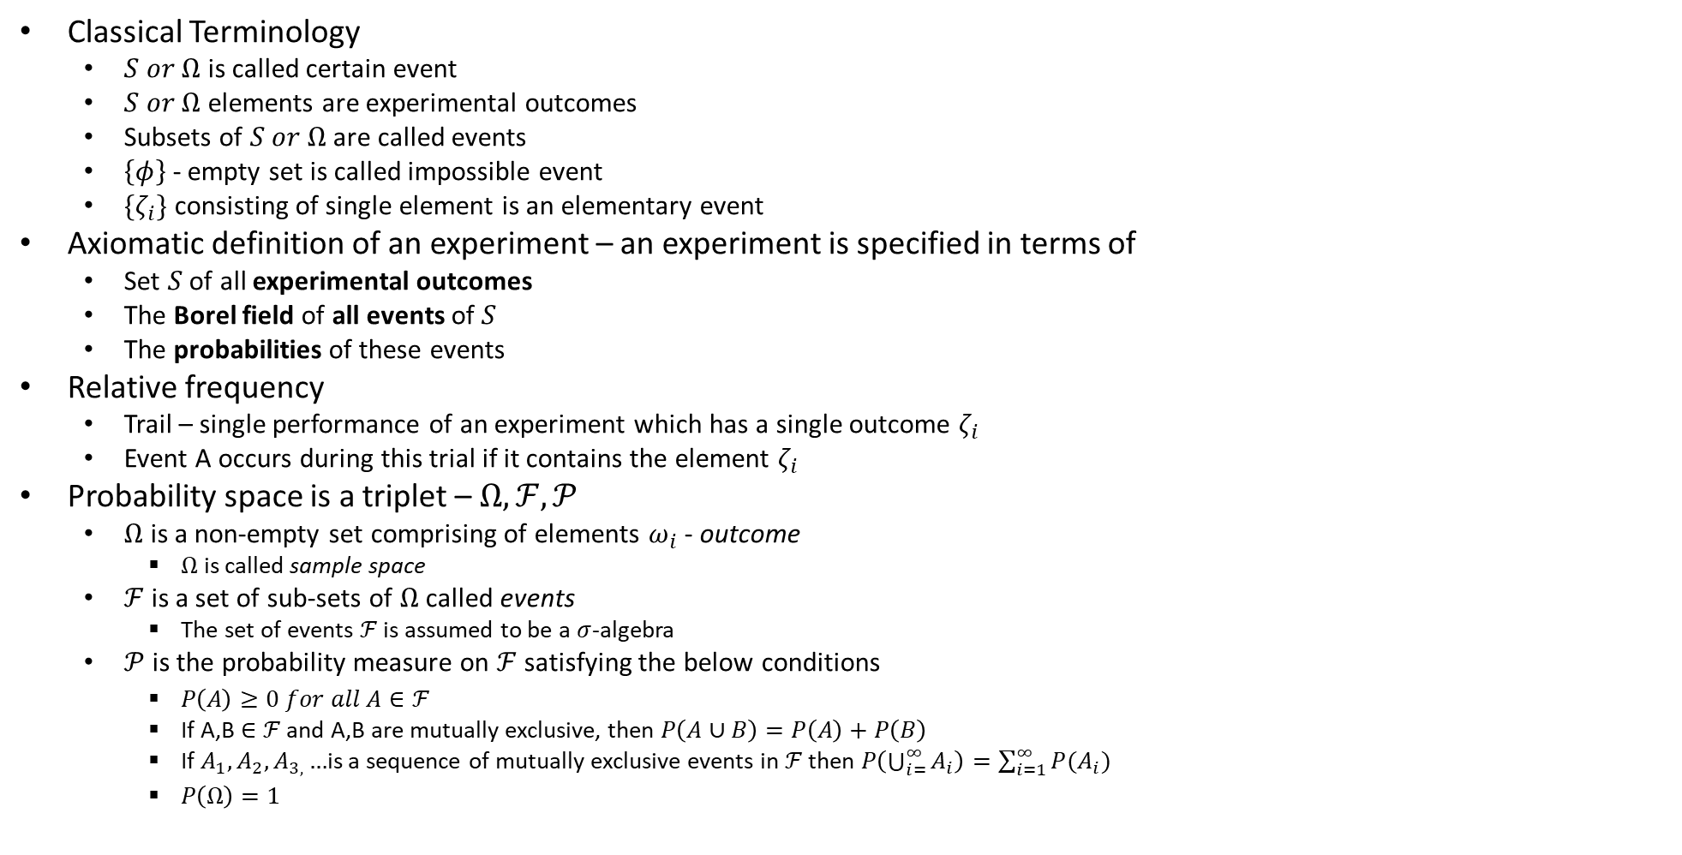
Probability – Spaces
Classical Terminology
$S or Ω$ is called certain event
$S or Ω$ elements are experimental outcomes
Subsets of $S or Ω$ are called events
$\left\{φ\right\}$ - empty set is called impossible event
$\{ζ_{i}\}$ consisting of single element is an elementary event
Axiomatic definition of an experiment – an experiment is specified in terms of
Set $S$ of all experimental outcomes
The Borel field of all events of $S$
The probabilities of these events
Relative frequency
Trail – single performance of an experiment which has a single outcome $ζ_{i}$
Event A occurs during this trial if it contains the element $ζ_{i}$
Probability space is a triplet – $Ω,ℱ,𝒫$
$Ω$ is a non-empty set comprising of elements $ω_{i}$ - outcome
$Ω$ is called sample space
$ℱ$ is a set of sub-sets of $Ω$ called events
The set of events $ℱ$ is assumed to be a $σ$-algebra
$𝒫$ is the probability measure on $ℱ$ satisfying the below conditions
$P\left(A\right)≥0 for all A∈ℱ$
If A,B$∈ℱ$ and A,B are mutually exclusive, then $P\left(A∪B\right)=P\left(A\right)+P\left(B\right)$
If $A_{1},A_{2},A_{3,}…$is a sequence of mutually exclusive events in $ℱ$ then $P\left(\bigcup_{i=}^{∞}{A_{i}}\right)=\sum_{i=1}^{∞}{P(A_{i})}$
$P\left(Ω\right)=1$
Based on the conditions on to the left, the following properties are implied
If $A⊂B then P\left(A\right)≤P\left(B\right)$
$P\left(A∪B\right)=P\left(A\right)+P\left(B\right)−P\left(A∩B\right)$
$P\left(A∪B∪C\right)=P\left(A\right)+P\left(B\right)+P\left(C\right)−P\left(A∩B\right)−P\left(A∩C\right)−P\left(B∩C\right)+P(A∩B∩C)$
$P\left(A\right)+P\left(A^{c}\right)=1$
$P\left(φ\right)=0$

Slide 5
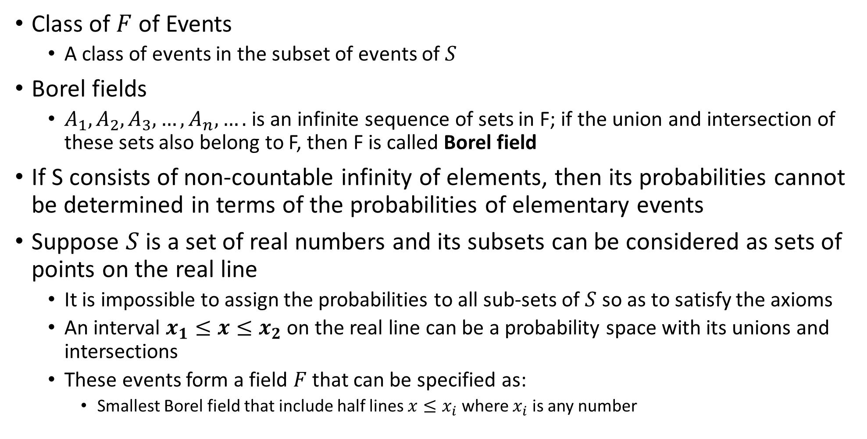
Probability – Spaces
Class of $F$ of Events
A class of events in the subset of events of $S$
Borel fields
$A_{1},A_{2},A_{3},…,A_{n},….$ is an infinite sequence of sets in F; if the union and intersection of these sets also belong to F, then F is called Borel field
If S consists of non-countable infinity of elements, then its probabilities cannot be determined in terms of the probabilities of elementary events
Suppose $S$ is a set of real numbers and its subsets can be considered as sets of points on the real line
It is impossible to assign the probabilities to all sub-sets of $S$ so as to satisfy the axioms
An interval $x_{1}≤x≤x_{2}$ on the real line can be a probability space with its unions and intersections
These events form a field $F$ that can be specified as:
Smallest Borel field that include half lines $x≤x_{i}$ where $x_{i}$ is any number

Slide 6
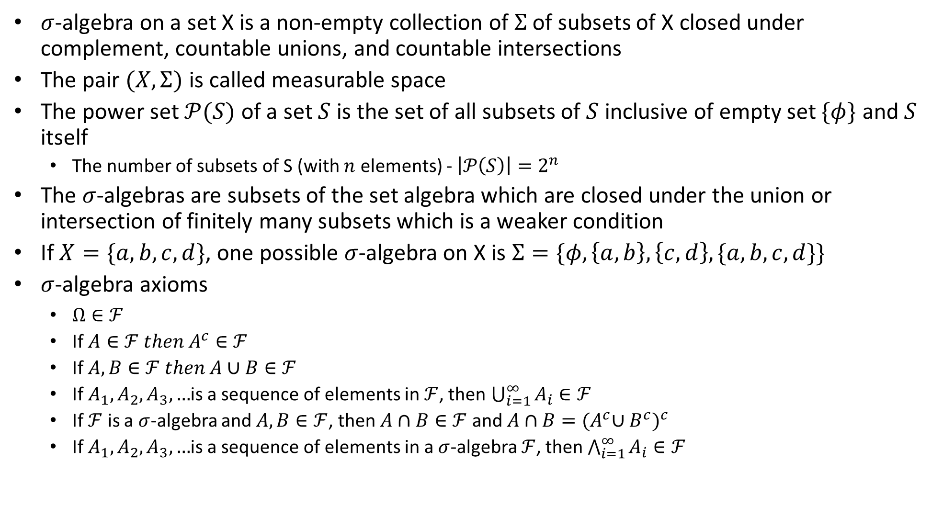
$σ$-Algebra ($σ$-field)
$σ$-algebra on a set X is a non-empty collection of $Σ$ of subsets of X closed under complement, countable unions, and countable intersections
The pair $(X,Σ)$ is called measurable space
The power set $𝒫(S)$ of a set $S$ is the set of all subsets of $S$ inclusive of empty set $\{φ\}$ and $S$ itself
The number of subsets of S (with $n$ elements) - $\left|𝒫\left(S\right)\right|=2^{n}$
The $σ$-algebras are subsets of the set algebra which are closed under the union or intersection of finitely many subsets which is a weaker condition
If $X=\{a,b,c,d\}$, one possible $σ$-algebra on X is $Σ=\{φ, \left\{a,b\right\},\left\{c,d\right\},\{a,b,c,d\}\}$
$σ$-algebra axioms
$Ω∈ℱ$
If $A∈ℱ then A^{c}∈ℱ$
If $A,B∈ℱ then A∪B∈ℱ$
If $A_{1},A_{2},A_{3},…$is a sequence of elements in $ℱ$, then $\bigcup_{i=1}^{∞}{A_{i}∈ℱ}$
If $ℱ$ is a $σ$-algebra and $A,B∈ℱ$, then $A∩B∈ℱ$ and $A∩B={{(A}^{c}∪B^{c})}^{c}$
If $A_{1},A_{2},A_{3},…$is a sequence of elements in a $σ$-algebra $ℱ$, then $\bigwedge_{i=1}^{∞}{A_{i}∈ℱ}$

Slide 7
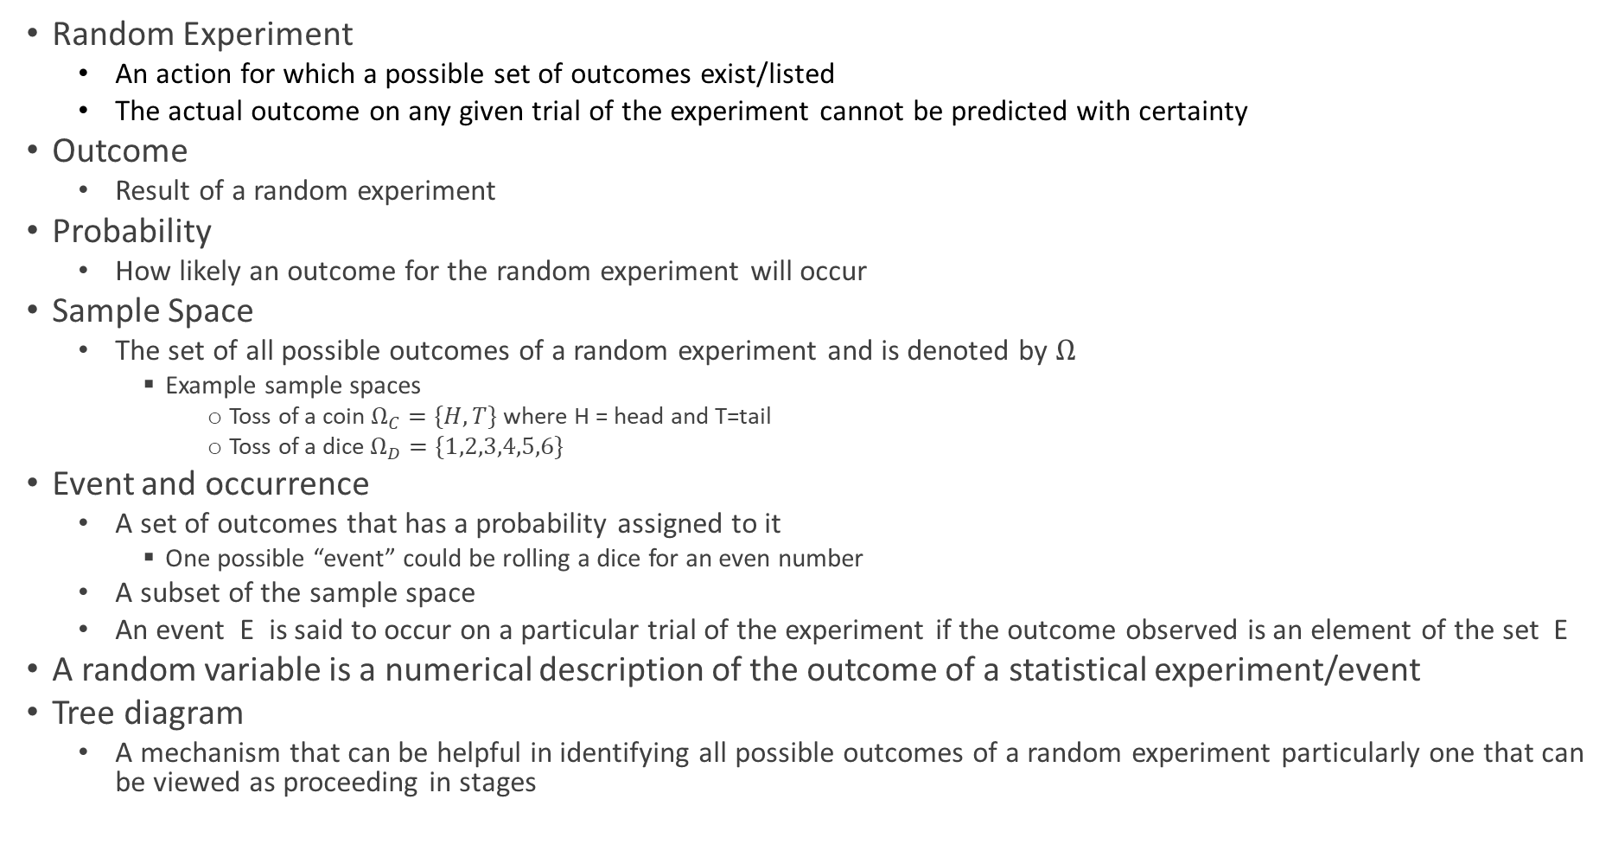
Terminology
Random Experiment
An action for which a possible set of outcomes exist/listed
The actual outcome on any given trial of the experiment cannot be predicted with certainty
Outcome
Result of a random experiment
Probability
How likely an outcome for the random experiment will occur
Sample Space
The set of all possible outcomes of a random experiment and is denoted by $Ω$
Example sample spaces
Toss of a coin $Ω_{C}=\{H, T\}$ where H = head and T=tail
Toss of a dice $Ω_{D}=\{1,2,3,4,5,6\}$
Event and occurrence
A set of outcomes that has a probability assigned to it
One possible “event” could be rolling a dice for an even number
A subset of the sample space
An event E is said to occur on a particular trial of the experiment if the outcome observed is an element of the set E
A random variable is a numerical description of the outcome of a statistical experiment/event
Tree diagram
A mechanism that can be helpful in identifying all possible outcomes of a random experiment particularly one that can be viewed as proceeding in stages

Slide 8

Probabilities
Different probabilities
Marginal (unconditional) probability $P\left(A\right)$ is the probability of an event irrespective of the outcome of another variable
Conditional probability $P(A|B)$ – Probability of event A occurring, given that event B occurs - is the probability of one event occurring in the presence of a second event
Joint probability $P(A,B)$ - Probability of events A and B occurring - is the probability of two events occurring simultaneously

Slide 9
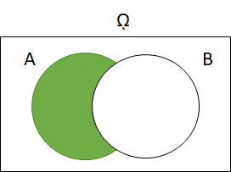
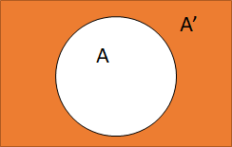
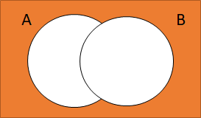

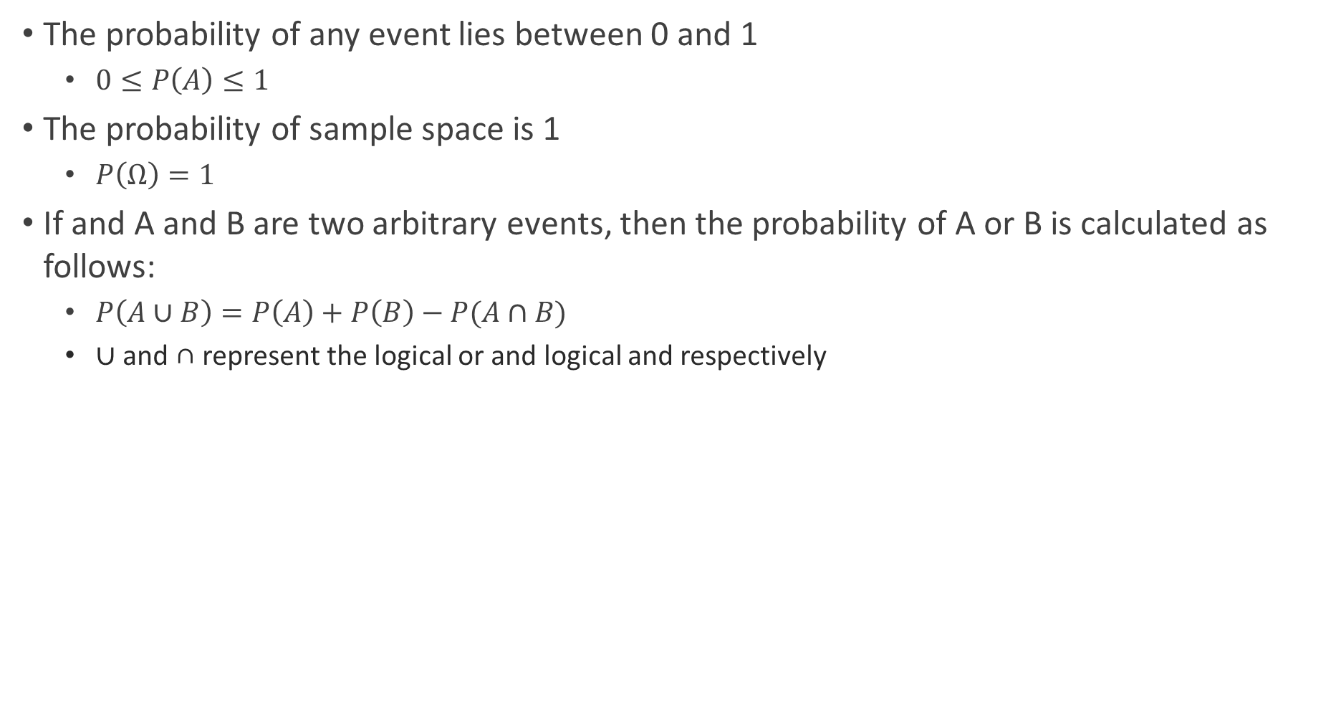


Well-known Probability Axioms
The probability of any event lies between 0 and 1
$0≤P\left(A\right)≤1$
The probability of sample space is 1
$P\left(Ω\right)=1$
If and A and B are two arbitrary events, then the probability of A or B is calculated as follows:
$P\left(A∪B\right)=P\left(A\right)+P\left(B\right)−P(A∩B)$
∪ and ∩ represent the logical or and logical and respectively
$$P\left(A^{′}\right)=1−P(A)$$
$$P\left(A−B\right)=P(A∩B^{′})$$
$$P\left(A∪B\right)′=P(A′∩B^{′})$$

Slide 10
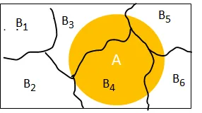
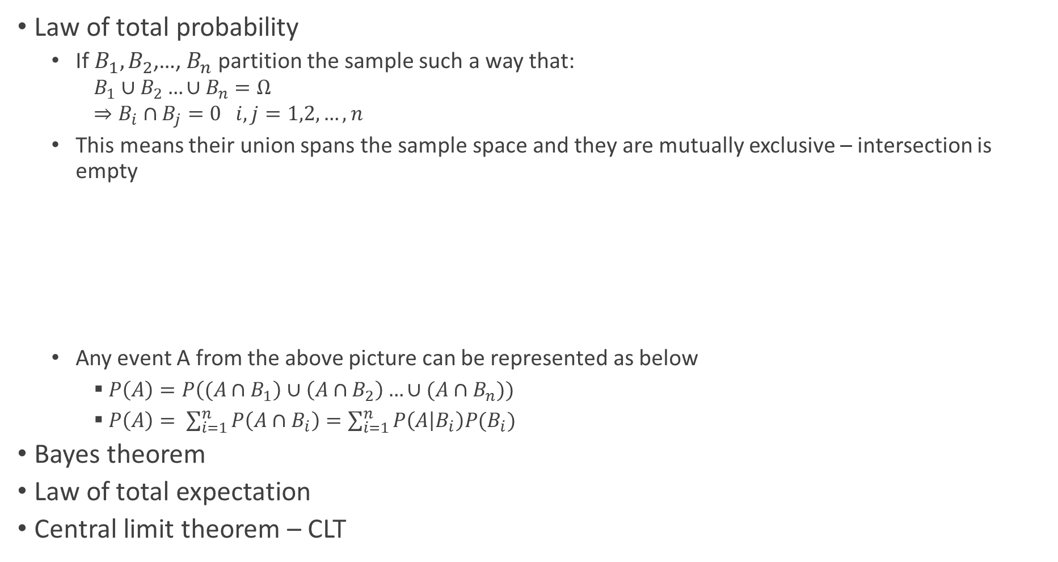
Important Theorems in Probability
Law of total probability
If $B_{1},B_{2}$,…, $B_{n}$ partition the sample such a way that:
$$B_{1}∪B_{2}…∪B_{n}=Ω$$
$$⇒B_{i}∩B_{j}=0 i,j=1,2,…,n$$
This means their union spans the sample space and they are mutually exclusive – intersection is empty
Any event A from the above picture can be represented as below
$P\left(A\right)=P\left((A∩B_{1}\right)∪\left(A∩B_{2}\right)…∪(A∩B_{n}))$
$P\left(A\right)= \sum_{i=1}^{n}{P\left(A∩B_{i}\right)=\sum_{i=1}^{n}{P\left(A | B_{i}\right)P(B_{i})}}$
Bayes theorem
Law of total expectation
Central limit theorem – CLT

Slide 11

Probability Axioms – Kolmogorov Axioms
Axioms - Kolmogorov axioms
$P\left(A\right)≥0⇒P\left(A\right)=1−P(\overline{A})$
$P\left(S\right)=1$
$If A∩B=\left\{φ\right\} then P\left(A∪B\right)=P\left(A\right)+P(B)$
For any A and B
$P\left(A∪B\right)=P\left(A\right)+P\left(B\right)−P\left(A∩B\right)≤P\left(A\right)+P(B)$
If events $A_{1},A_{2},A_{3},…A_{n}$ are mutually exclusive, then
$P\left(A_{1}∪A_{2}…∪A_{n}\right)=P(A_{1)}+P\left(A_{2}\right)+P\left(A_{3}\right)+…+P(A_{n})$ – axiom of infinite additivity

Slide 12

Standard Unit-interval Probability Space
$Ω=\{ω:0≤ω≤1\}$
We want the set of events $ℱ$ to include intervals and probability of interval [a,b] with $0≤a≤b≤1$ to be given by:
$P\left(\left[a,b\right]\right)=b−a$

Slide 13
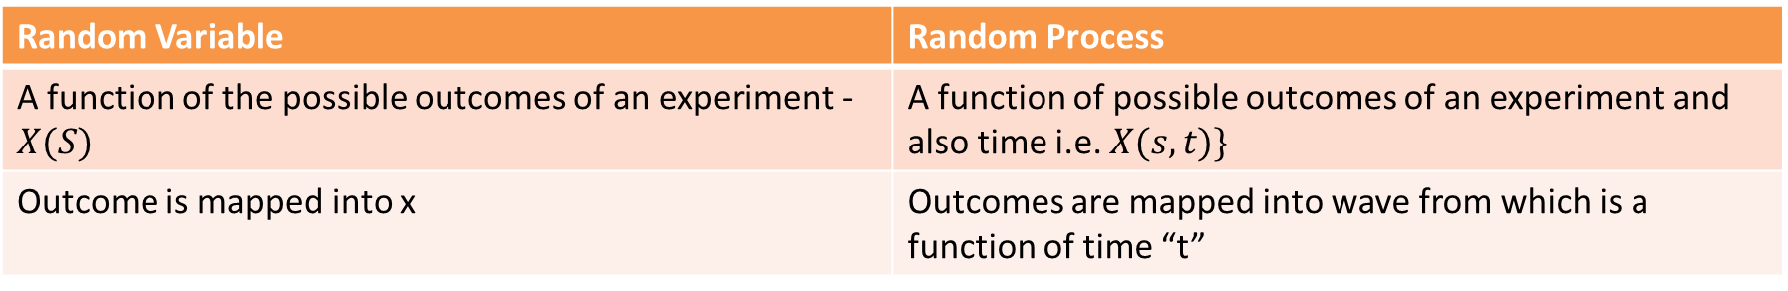
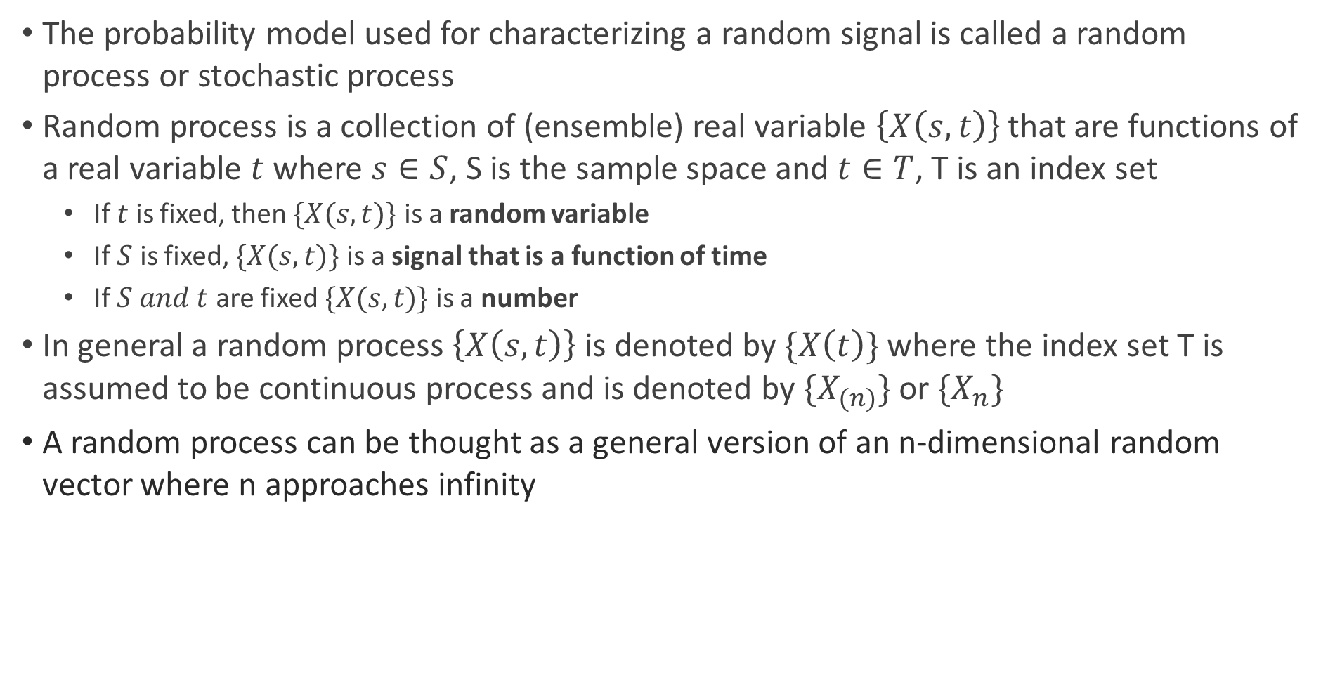
Random Process and Variables
The probability model used for characterizing a random signal is called a random process or stochastic process
Random process is a collection of (ensemble) real variable $\left\{X\left(s,t\right)\right\}$ that are functions of a real variable $t$ where $s∈S$, S is the sample space and $t∈T$, T is an index set
If $t$ is fixed, then $\{X(s,t)\}$ is a random variable
If $S$ is fixed, $\{X(s,t)\}$ is a signal that is a function of time
If $S and t$ are fixed $\{X(s,t)\}$ is a number
In general a random process $\left\{X\left(s,t\right)\right\}$ is denoted by $\{X\left(t\right)\}$ where the index set T is assumed to be continuous process and is denoted by $\{X_{(n)}\}$ or ${\{X}_{n}\}$
A random process can be thought as a general version of an n-dimensional random vector where n approaches infinity
Random Variable | Random Process
A function of the possible outcomes of an experiment - $X(S)$ | A function of possible outcomes of an experiment and also time i.e. $X(s,t)\}$
Outcome is mapped into x | Outcomes are mapped into wave from which is a function of time “t”

Slide 14
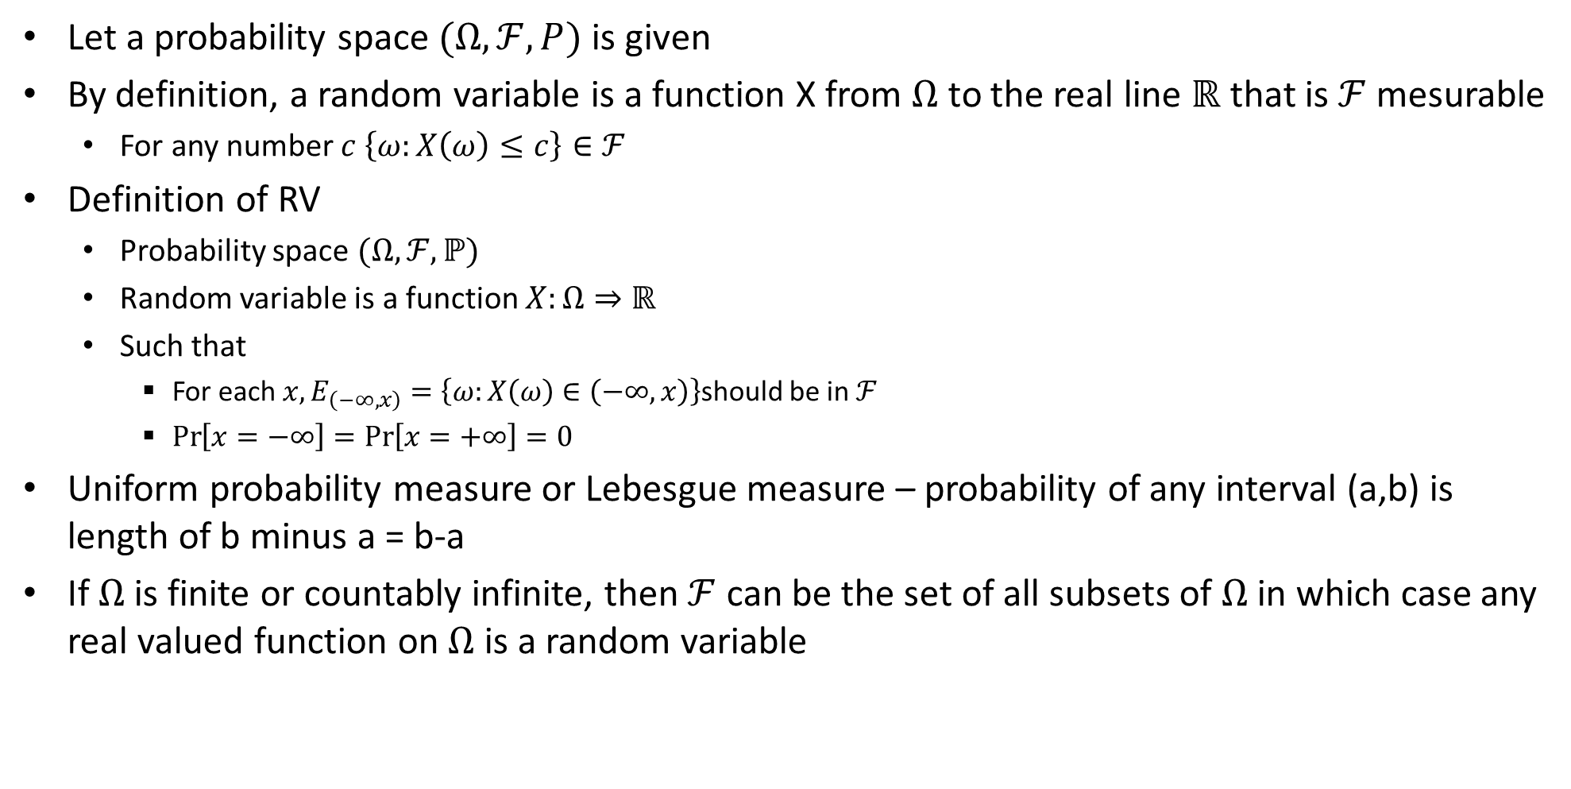
Random Variables and Their Distribution
Let a probability space $(Ω,ℱ,P)$ is given
By definition, a random variable is a function X from $Ω$ to the real line $ℝ$ that is $ℱ$ mesurable
For any number $c \left\{ω:X\left(ω\right)≤c\right\}∈ℱ$
Definition of RV
Probability space $(Ω, ℱ, ℙ)$
Random variable is a function $X:Ω⇒ℝ$
Such that
For each $x, E_{\left(−∞, x\right)}=\left\{ω:X\left(ω\right)∈\left(−∞, x\right)\right\}$should be in $ℱ$
$\operatorname{Pr}\left[x=−∞\right]=\operatorname{Pr}\left[x=+∞\right]=0$
Uniform probability measure or Lebesgue measure – probability of any interval (a,b) is length of b minus a = b-a
If $Ω$ is finite or countably infinite, then $ℱ$ can be the set of all subsets of $Ω$ in which case any real valued function on $Ω$ is a random variable

Slide 15
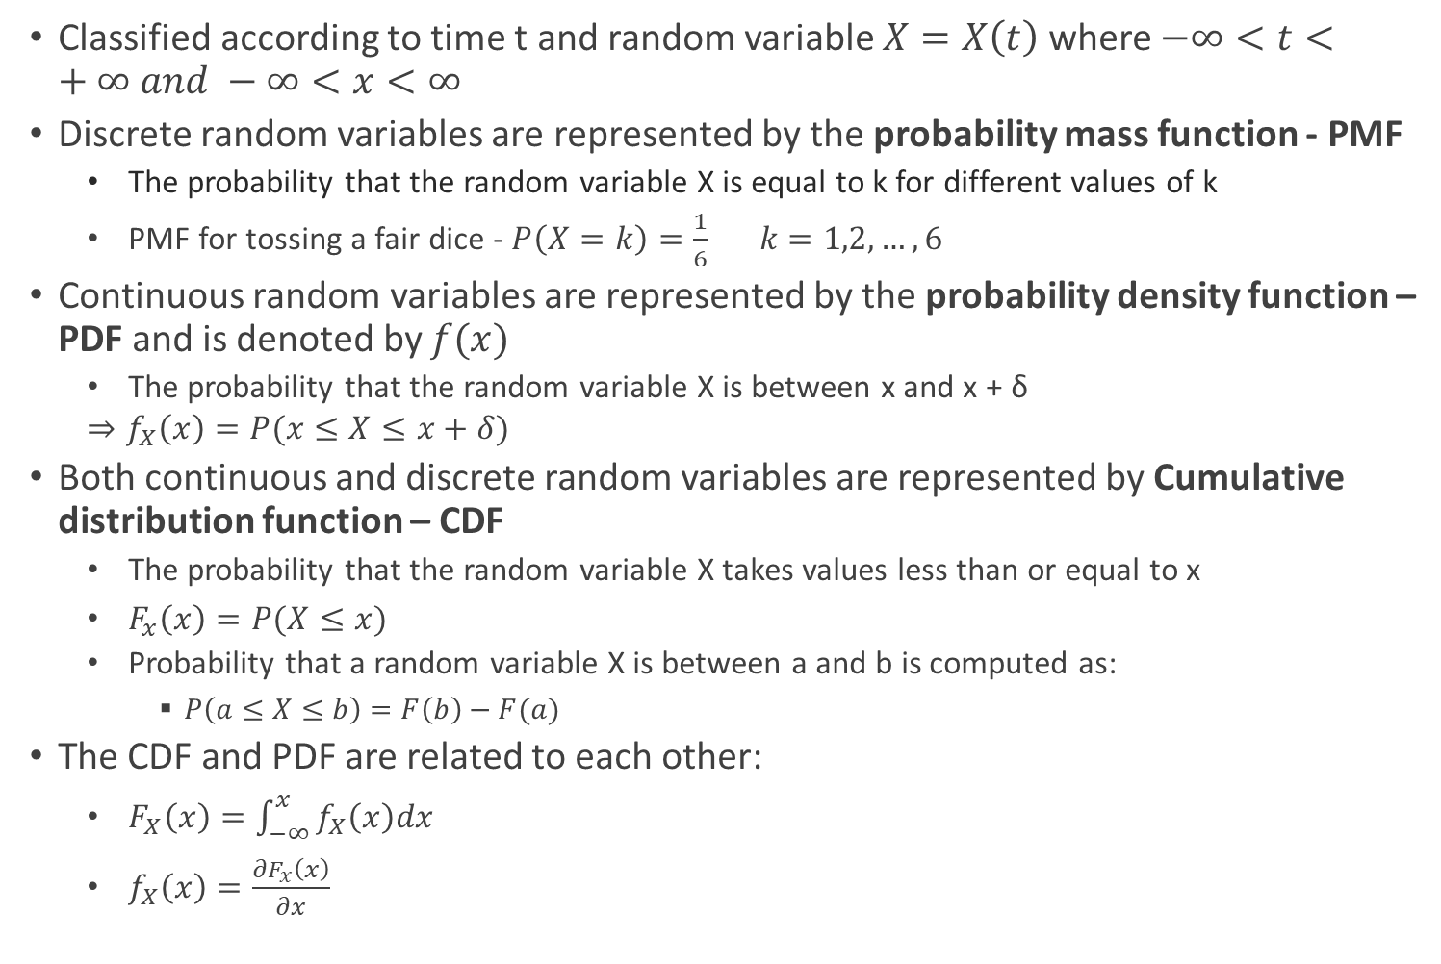
Classification of Random Processes
Classified according to time t and random variable $X=X\left(t\right)$ where $−∞<t<+∞ and −∞<x<∞$
Discrete random variables are represented by the probability mass function - PMF
The probability that the random variable X is equal to k for different values of k
PMF for tossing a fair dice - $P\left(X=k\right)=\frac{1}{6} k=1,2,…,6$
Continuous random variables are represented by the probability density function – PDF and is denoted by $f(x)$
The probability that the random variable X is between x and x + δ
$$⇒f_{X}\left(x\right)=P(x≤X≤x+δ)$$
Both continuous and discrete random variables are represented by Cumulative distribution function – CDF
The probability that the random variable X takes values less than or equal to x
$F_{x}\left(x\right)=P(X≤x)$
Probability that a random variable X is between a and b is computed as:
$P\left(a≤X≤b\right)=F\left(b\right)−F(a)$
The CDF and PDF are related to each other:
$F_{X}\left(x\right)=\int_{−∞}^{x}{f_{X}\left(x\right)dx}$
$f_{X}\left(x\right)=\frac{∂F_{x}\left(x\right)}{∂x}$
Random Process is a function of
Random Variables $\{X\left(s\right)\}$
Random Variables {𝑋(𝑠)}
Time$t$
Time 𝑡
Discrete
Continuous
Discrete
Continuous

Slide 16
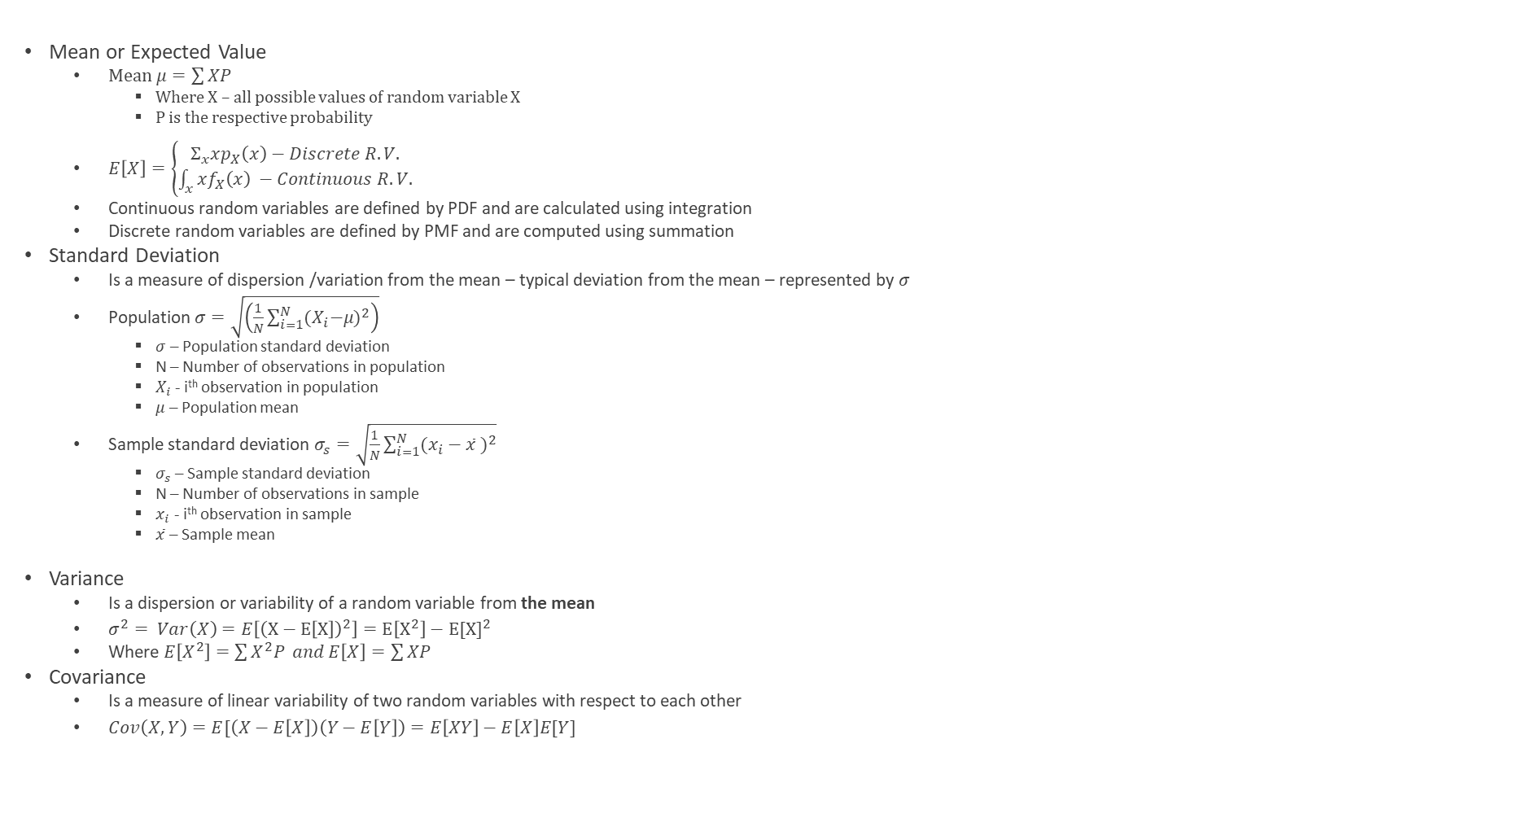
Properties of Random Variable
Mean or Expected Value
Mean $μ=\sum{XP}$
Where X – all possible values of random variable X
P is the respective probability
$E\left[X\right]=\left\{\begin{aligned}Σ_{x}xp_{X}\left(x\right)−Discrete R.V. \\ \int_{x}^{ }{xf_{X}\left(x\right) −Continuous R.V.}\end{aligned}\right.$
Continuous random variables are defined by PDF and are calculated using integration
Discrete random variables are defined by PMF and are computed using summation
Standard Deviation
Is a measure of dispersion /variation from the mean – typical deviation from the mean – represented by $σ$
Population $σ=\sqrt{\left(\frac{1}{N}\sum_{i=1}^{N}{{{(X}_{i}−μ)}^{2}}\right)}$
$σ$ – Population standard deviation
N – Number of observations in population
$X_{i}$ - i^{th} observation in population
$μ$ – Population mean
Sample standard deviation $σ_{s}=\sqrt{\frac{1}{N}\sum_{i=1}^{N}{{(x_{i}−\overline{x} )}^{2}}}$
$σ_{s}$ – Sample standard deviation
N – Number of observations in sample
$x_{i}$ - i^{th} observation in sample
$\overline{x}$ – Sample mean
Variance
Is a dispersion or variability of a random variable from the mean
$σ^{2}= Var\left(X\right)=E\left[{\left(X−E\left[X\right]\right)}^{2}\right]=E\left[X^{2}\right]−E{[X]}^{2}$
Where $E\left[X^{2}\right]=\sum{X^{2}P} and E\left[X\right]=\sum{XP}$
Covariance
Is a measure of linear variability of two random variables with respect to each other
$Cov\left(X,Y\right)=E[\left(X−E\left[X\right]\right)\left(Y−E\left[Y\right]\right)=E\left[XY\right]−E\left[X\right]E[Y]$

Slide 17
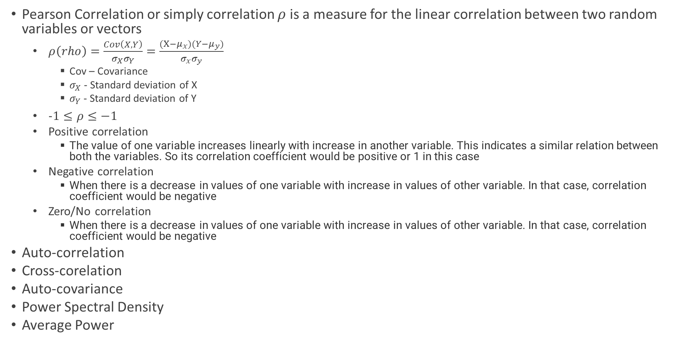
Properties of Random Variable
Pearson Correlation or simply correlation $ρ$ is a measure for the linear correlation between two random variables or vectors
$ρ\left(rho\right)=\frac{Cov\left(X,Y\right)}{σ_{X}σ_{Y}}=\frac{(X−μ_{x})(Y−μ_{y})}{σ_{x}σ_{y}}$
Cov – Covariance
$σ_{X}$ - Standard deviation of X
$σ_{Y}$ - Standard deviation of Y
$−1≤ρ≤−1$
Positive correlation
The value of one variable increases linearly with increase in another variable. This indicates a similar relation between both the variables. So its correlation coefficient would be positive or 1 in this case
Negative correlation
When there is a decrease in values of one variable with increase in values of other variable. In that case, correlation coefficient would be negative
Zero/No correlation
When there is a decrease in values of one variable with increase in values of other variable. In that case, correlation coefficient would be negative
Auto-correlation
Cross-corelation
Auto-covariance
Power Spectral Density
Average Power

Slide 18
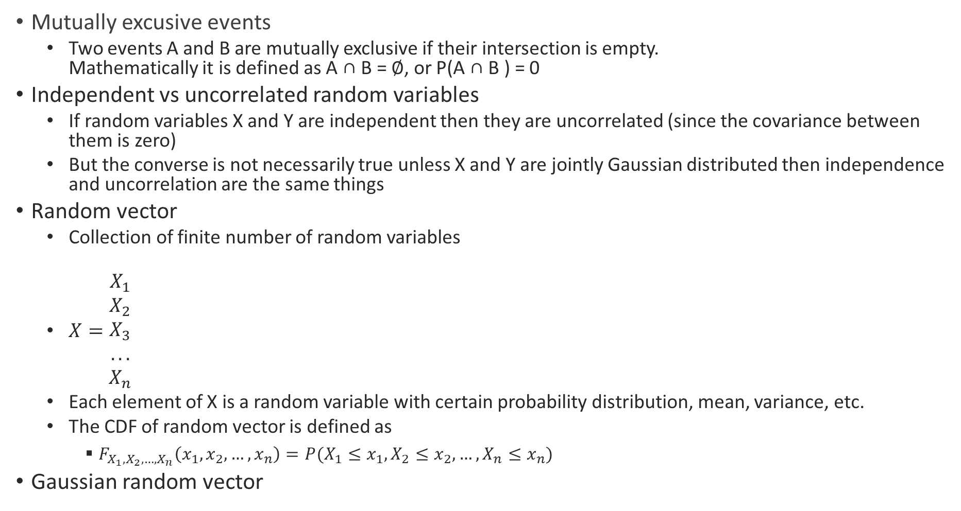
Properties of Random Variable
Mutually excusive events
Two events A and B are mutually exclusive if their intersection is empty. Mathematically it is defined as A ∩ B = ∅, or P(A ∩ B ) = 0
Independent vs uncorrelated random variables
If random variables X and Y are independent then they are uncorrelated (since the covariance between them is zero)
But the converse is not necessarily true unless X and Y are jointly Gaussian distributed then independence and uncorrelation are the same things
Random vector
Collection of finite number of random variables
$X=\begin{matrix}X_{1} \\ X_{2} \\ \begin{aligned}X_{3} \\ ... \\ X_{n}\end{aligned}\end{matrix}$
Each element of X is a random variable with certain probability distribution, mean, variance, etc.
The CDF of random vector is defined as
$F_{X_{1},X_{2},…,X_{n}}\left(x_{1}, x_{2},…,x_{n}\right)=P(X_{1}≤x_{1}, X_{2}≤x_{2},…, X_{n}≤x_{n})$
Gaussian random vector

Slide 19
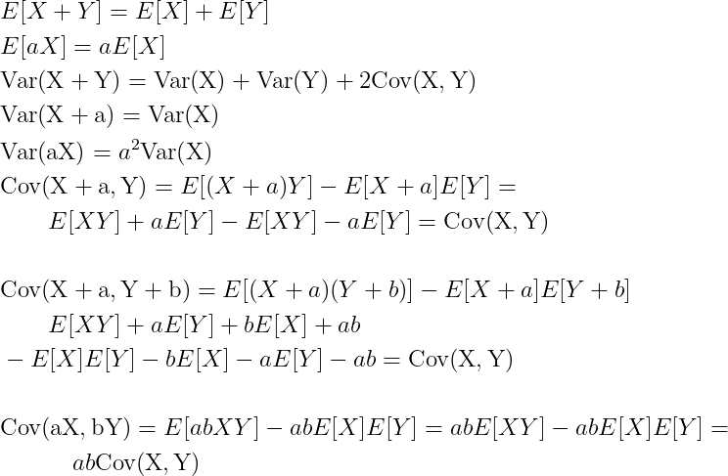
Properties of Random Variable
Assume X and Y are two arbitrary random variables and a and b are two scalars, then the following are some of the important properties of the expected value, variance, and covariance

Slide 20
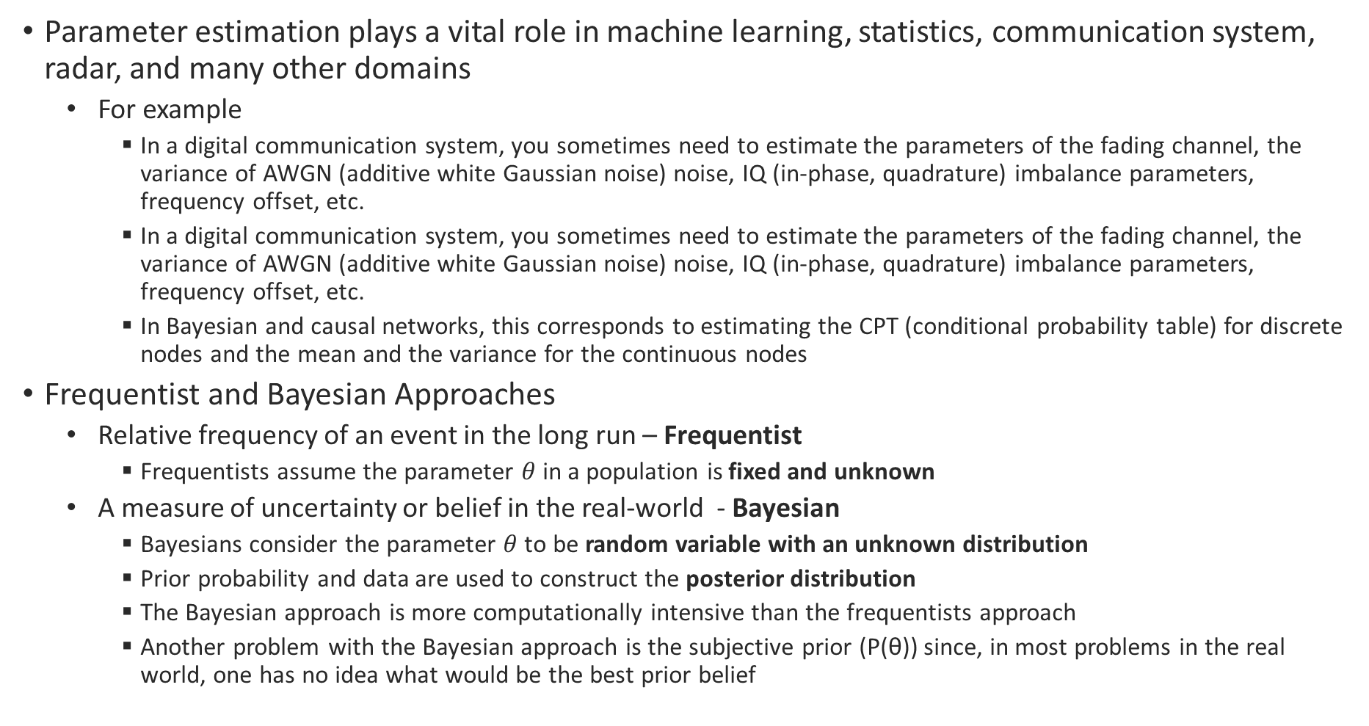
Parameter Estimation Techniques
Parameter estimation plays a vital role in machine learning, statistics, communication system, radar, and many other domains
For example
In a digital communication system, you sometimes need to estimate the parameters of the fading channel, the variance of AWGN (additive white Gaussian noise) noise, IQ (in-phase, quadrature) imbalance parameters, frequency offset, etc.
In a digital communication system, you sometimes need to estimate the parameters of the fading channel, the variance of AWGN (additive white Gaussian noise) noise, IQ (in-phase, quadrature) imbalance parameters, frequency offset, etc.
In Bayesian and causal networks, this corresponds to estimating the CPT (conditional probability table) for discrete nodes and the mean and the variance for the continuous nodes
Frequentist and Bayesian Approaches
Relative frequency of an event in the long run – Frequentist
Frequentists assume the parameter $θ$ in a population is fixed and unknown
A measure of uncertainty or belief in the real-world - Bayesian
Bayesians consider the parameter $θ$ to be random variable with an unknown distribution
Prior probability and data are used to construct the posterior distribution
The Bayesian approach is more computationally intensive than the frequentists approach
Another problem with the Bayesian approach is the subjective prior (P(θ)) since, in most problems in the real world, one has no idea what would be the best prior belief

Slide 21
Parameter Estimation Techniques contd…
MLE – Maximum Likelihood Estimation
MLE estimation tries to find the estimate of the parameter θ by maximizing the likelihood function
MAP – Maximum a Posteriori Estimation
MMSE – Minimum Mean Square Error Estimation
Least Square Estimation
Bayes Estimation

Slide 22

Random Variable Cumulative Distribution Function - CDF
The CDF of a random variable X is defined as the probability that X takes a value less than or equal to x
$F_{X}\left(x\right)=ℙ\left(\left\{ω:X\left(ω\right)≤x\right\}\right)=ℙ\left(\left\{ω:X\left(ω\right)∈\left(−∞,x\right]\right\}\right)=ℙ_{X}((−∞,x])$
CDF at $x$ can be seen as the probability mass of the interval $(−∞, x]$

Slide 23

Independence of RVs
The random variables are mutually independent if :
$ℙ\left(X∈B_{1}, Y∈B_{2}\right)=ℙ\left(X∈B_{1}\right)ℙ(X_{2}∈B)$ for any $B_{1},B_{2}$
It implies
Joint CDF ${ F}_{X,Y}\left(x,y\right)=F_{X}\left(x\right).F_{Y}(y)$
Joint PMF $p_{X,Y}\left(x,y\right)=p_{X}\left(x\right){.p}_{Y}(y)$
Joint PDF $f_{X,Y}\left(x,y\right)=f_{X}\left(x\right).f_{Y}(y)$
CDF of a random variable given an event A
$F_{X|A}\left(x\right)=ℙ_{X|A}\left(\left\{ω:X\left(ω\right)≤x\right\} | A\right)$
=$\frac{ℙ\left(\left\{ω:X\left(ω\right)≤x \& w∈A\right\}\right)}{ℙ\left(A\right)}$
xx

Slide 24

Independence and Conditional Probability
If A and B are events and $P\left(B\right)≠0$, then the conditional probability of A given B is defined by
$P\left(A\right|B)=\frac{P\left(AB\right)}{P\left(B\right)} (P\left(B\right)≠0)$

Slide 25

RV Examples
Bernoulli RV
$X=Bern(p)$ – X has Bernoulli distribution with parameter $p$
Takes only two values – 0 and 1
PMF
$p_{X}\left(x\right)=\left\{\begin{aligned}1−p, if x=0 \\ p, if x=1 \\ 0, otherwise\end{aligned}\right.$
CDF
$F_{X}\left(x\right)=\left\{\begin{aligned}0, if x<0 \\ 1−p, if 0≤x<1 \\ 1, if x≥1\end{aligned}\right.$

